Slide 1
The U.S. GAAP Governmental Taxonomy Prototype: Life Beyond Excel Spreadsheets & PDFs
Presented by
Shannon Sohl, PhD, CPA– NIU Center for Governmental Studies Senior Research Associate
Marc Joffe (???)

Slide 2
Overview
Describe the current state of reporting
Demonstrate increased semantics and standardization
Demonstrate machine-readability
Demonstrate data re-usability

Slide 3
It’s time for a change!

Slide 4
Many Consumers of Financial Information with Different Needs
States
(i.e., AFR’s)
MSRB (EMMA)
Bond Rating Agencies
Auditors
Businesses, Investors & Financial Institutions
U.S. Census Bureau
Prof. Assoc. (i.e., AGA, AICPA, GFOA)
Elected Officials
Citizens
FAC (Single Audits or A-133’s)
Academia
The U.S. has about 90,000 States and LG’s (8,500 in IL) with many providing financial reports to all, or some combination, of these stakeholders.
Notes:
The scope of CAFRs..are accountability tools with many stakeholders of which much of the information has to be re-formatted or reshuffled to meet the reporting requirements of those they are submitting information. Reporting to all accountability holders in a given year can be quite cumbersome and time consuming.

Slide 5
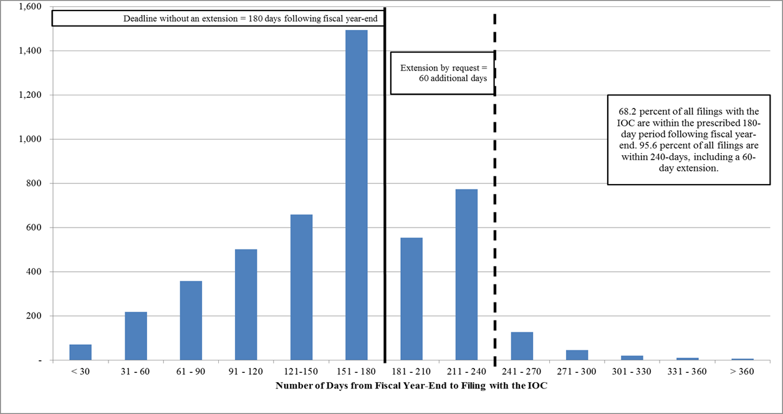
Reporting Lag in Illinois
5
Notes:
In fact, reporting takes, on average, 179 days to produce reports at the Comptroller’s site in Illinois. About a third of our local governments report past 180 days.

Slide 6

Real Example of a Typo
Notes:
Annual Audits are crafted via dozens of Excel sheets and posted as PDFs. Manual creation of reports leads to copy and paste errors.

Slide 7
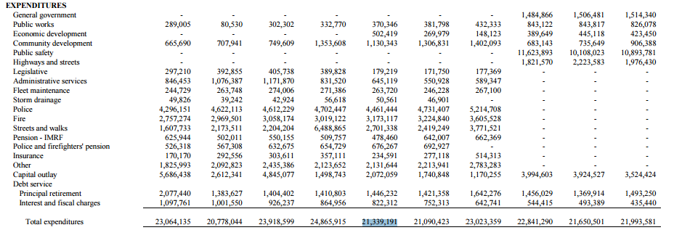

Real Example of a Change in Reporting Policy
Notes:
Changes in accounting for financial information causes confusion or inaccurate analytical results. In this case, the user does not know for certain how the accounts are now being rolled up into new concepts and the prior years were not restated.

Slide 8
Discretion in Reporting Concepts Example: An IL County
Variation in reporting a basic concept, Cash related concepts:
Cash and Cash Equivalents (21%)
Cash and Investments (69%)
Cash
Investments
Deposits
Broken down by Demand Deposits and Certificate Deposits
90%
10%
Notes:
90% of municipalities reported either Cash and CE or Cash and Investments. Three other concepts were used for the remaining 10%.
Typically there are four to five type of General Governmental Activities line items. We found 26 different concepts in this section for this county.
Debit balance (b&w)
Reported with assets (b&w)
Positive balance (b&w)
Short term or long term asset? (what if you have held that asset for 2 years now?)
This is a real question the GASB is considering. Land held for resale does not have a clear definition. This is where a data dictionary can be helpful.

Slide 9
Discretion in Reporting Concepts An IL County (continued)
Variation in reporting General Government Activities:
26 different concepts reported just in municipalities alone even though, on average each entity reports only four types of General Government Activities concepts. Most frequently reported in County X’s municipalities include:
General Government (76%)
Public Safety (71%)
Highways and Streets (37%)
Interest (32%)
Culture & Recreation (29%)
Public Works (29%)
Notes:
90% of municipalities reported either Cash and CE or Cash and Investments. Three other concepts were used for the remaining 10%.
Typically there are four to five type of General Governmental Activities line items. We found 26 different concepts in this section for this county.
Debit balance (b&w)
Reported with assets (b&w)
Positive balance (b&w)
Short term or long term asset? (what if you have held that asset for 2 years now?)
This is a real question the GASB is considering. Land held for resale does not have a clear definition. This is where a data dictionary can be helpful.

Slide 10

Notes:
And even if standardization, data linkage and validation were achieved, we are still left with PDFs.

Slide 11
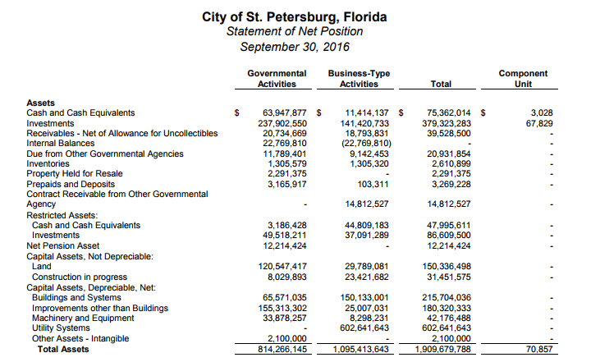
Reporting Is Cumbersome, Costly and Not Timely
PDF
Notes:
And looking for data such as cash and cash equivalents within a PDF is clumsy, especially within those PDFs scanned into a report repository.

Slide 12
Information gains meaning & structure!

Slide 13
XBRL for Governmental Reporting
Used in more than 50 countries and
Millions of paper reports are being replaced by digital reports each year
eXtensible Business Reporting Language (XBRL)
Clear definitions: authoritatively defined
Increased validity: Business rules allow for greater testing of information
Ease in sharing: platform-independent
Digital: like going from film photography to digital photography
Source: www.xbrl.org

Slide 14
Notes:
The first step of our initiative was to begin developing a dictionary to defined commonly reported concepts in the statement of net position. For instance, if you look at the concept “cash and cash equiv.” you will not that it is found in the statement of Net Position as a current asset, see the standard label, how it is derived, that it is an “instant” type (as of…); is not a header and is only a positive balance.

Slide 15
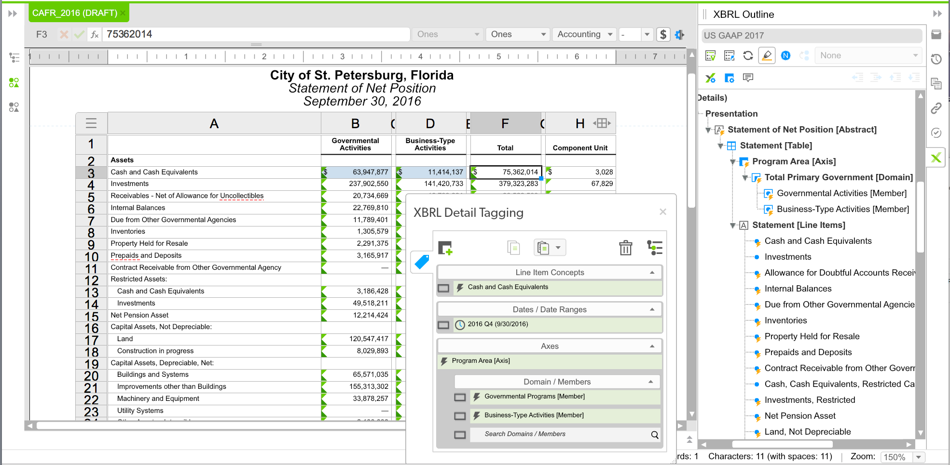
Notes:
Here cash and cash equiv. is digitized where the business rules and definitions are now associated with the concept.

Slide 16
Information becomes machine-readable!

Slide 17
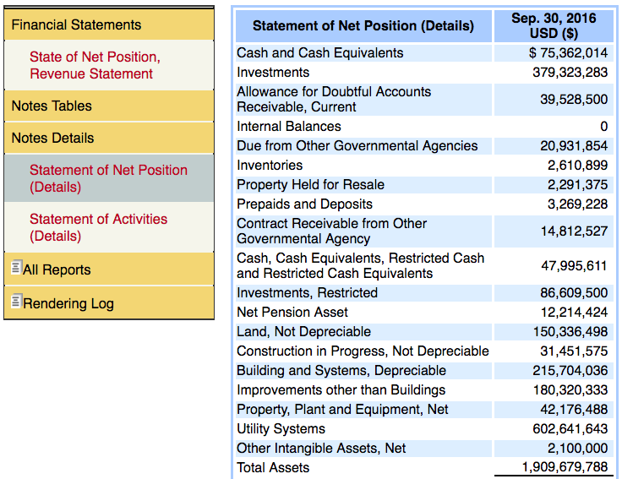
Notes:
Because the cash and cash equivalents concept is now digitized it can also be used to populate statements and tables where it must be reported. The reader can click on the concept for its definition and the preparer can be prevented from reporting errors (i.e., a negative cash balance).

Slide 18
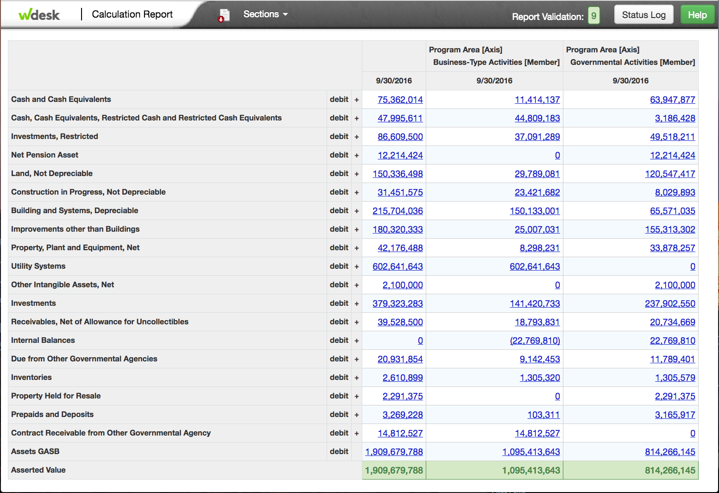
Notes:
Because cash and cash equivalents is now digitized it can also be used for a variety of calculations such as the quick ratio and linked to other parts of the report or even other reports without fear of Excel links breaking.

Slide 19
<us-gaap:CashCashEquivalentsRestrictedCashAndRestrictedCashEquivalents contextRef="FI2016Q4" decimals="0" id="Fact-F2" unitRef="usd">47995611</us_gaap:CashCashEquivalentsRestrictedCashAndRestrictedCashEquivalents>
<us-gaap:CashCashEquivalentsRestrictedCashAndRestrictedCashEquivalents contextRef="FI2016Q4_stp_ProgramAreaAxis_stp_BusinessTypeActivitiesMember” decimals="0" id="Fact-F3” unitRef="usd">44809183</us-Gaap:CashCashEquivalentsRestrictedCashAndRestrictedCashEquivalents>
<us-gaap:CashCashEquivalentsRestrictedCashAndRestrictedCashEquivalents contextRef="FI2016Q4_stp_ProgramAreaAxis_stp_GovernmentalProgramsMember” decimals="0" id="Fact-F4” unitRef="usd">3186428</us gaap:CashCashEquivalentsRestrictedCashAndRestrictedCashEquivalents>
<us-gaap:Investments contextRef="FI2016Q4" decimals="0" id="Fact-F5" unitRef="usd">379323283</us-gaap:Investments>
<us-gaap:Investments contextRef="FI2016Q4_stp_ProgramAreaAxis_stp_BusinessTypeActivitiesMember” decimals="0" id="Fact-F6” unitRef="usd">141420733</us-gaap:Investments>
<us-gaap:Investments contextRef="FI2016Q4_stp_ProgramAreaAxis_stp_GovernmentalProgramsMember” decimals="0" id="Fact-F7” unitRef="usd">237902550</us-gaap:Investments>
Notes:
These are a machine-readable representation of 6 facts in the XBRL syntax. There’s a reason these are called machine-readable. Only machines should have to read this!

Slide 20
Information becomes re-usable!

Slide 21
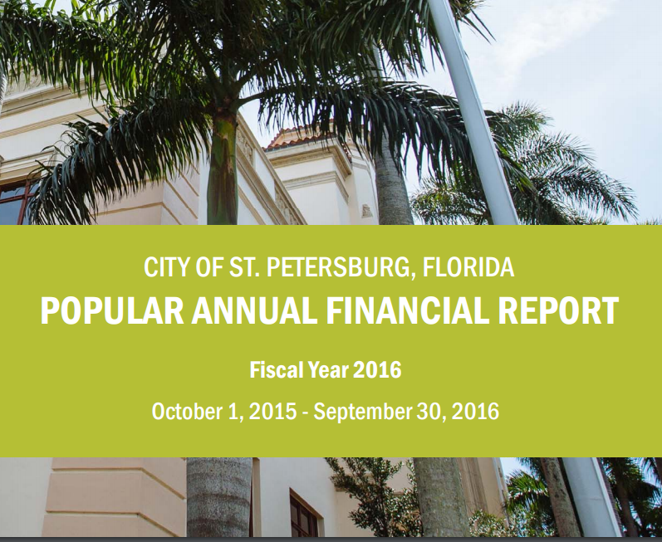

Slide 22
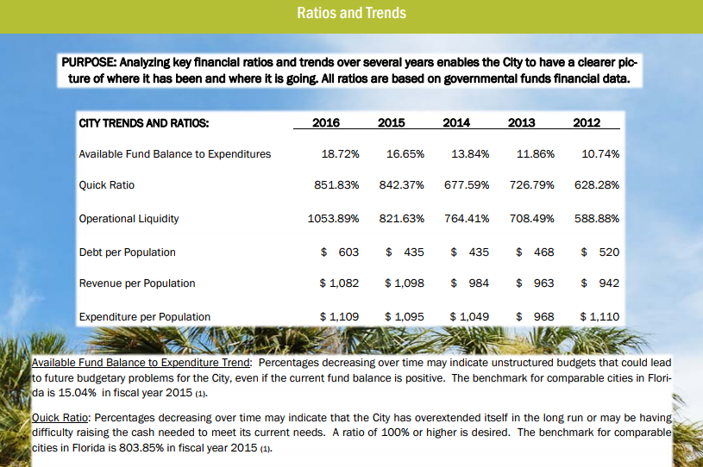

Slide 23
Where do we go from here?
Completion of the taxonomy
More use cases

